Slide 1

Airline Satisfaction Survey Machine Learning Project Apeksha Ingole, Samuel Klein

Slide 2
Customer Satisfaction Importance
Customer satisfaction is very crucial part of service in the airline industry.
Competitive Market: The airline industry is competitive. High satisfaction leads to more repeat customers, attracts new flyers and generate more revenue.
Financial Performance: Satisfied passengers are less likely to complain that translates to lower customer service costs for the airline. Additionally, happy customers might spend more on extras like onboard Wi-Fi or premium meals, boosting revenue.
Brand Image: High satisfaction levels are associated with positive brand perception, making the airline more attractive to travelers.

Slide 3

DATA PREPROCESSING

Slide 4
Data Upload:
CSV files from Kaggle website were uploaded, read and merged into a Pandas dataframe for analysis.
Data Cleaning :
Null values were found and removed
No duplicates were found
Unnecessary columns ‘Unnamed: 1’ and ‘id’ were dropped
Converted categorical features to numerical by using `pd.get_dummies()`
Data Splitting:
Used `train_test_split()` to divide data into training and testing sets.

Slide 5
Features Variables (X) | Target Variable (y)
'Age’, 'Flight Distance' | Satisfaction
'Inflight Wi-Fi service’, 'On-board service' | (1 for satisfied)
Departure/Arrival time convenient’, 'Class' | (0 for neutral/dissatisfied)
'Ease of Online booking’, 'Gate location',
'Departure Delay in Minutes’, 'Customer Type'
'Food and drink’, 'Online boarding'
'Seat comfort’, 'Inflight entertainment'
'Leg room service’, 'Gender',
'Check in service’, 'Baggage handling'
'Inflight service’, 'Cleanliness'
'Arrival Delay in Minutes’, 'Type of Travel'

Slide 6
MODEL DEVELOPMENT AND EVALUATION:
The following models were built, trained, and compared to predict passenger satisfaction.
Random Forest Classifier
Logistic Regression
Support Vector Classifier
K Nearest Neighbors Classifier
Naive Bayes Classifier
Decision Tree
Gradient Boosting Classifier
XBG Classifier

Slide 7
MODEL DEVELOPMENT AND EVALUATION:
Applied four techniques:
Scaling: Applied Standard Scaler.
Without applying Scaling
Outliers Removal: Used IQR technique to detect and remove outliers.
Log Transformation: Used np.log1p()
After splitting , each model is fitted by using model.fit(X_train and y_train)
The predictions are saved for the testing data labels by using model.predict(X_test)
Evaluated all the models using appropriate metrics such as accuracy score, classification report(precision, recall, f1 score), confusion matrix, and ROC-AUC.
Compared the performance of the different models to identify the best perming model

Slide 8
MODEL OPTIMIZATION:
Hyperparameter tuning was performed using Grid Search on the XGBoost Classifier, resulting in improved accuracy.
FEATURE IMPORTANCE:
Used feature importance function from XGBoost to identify the most important features.

Slide 9

DATA EXPLORATION

Slide 10
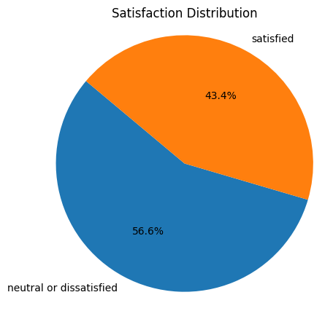

Slide 11
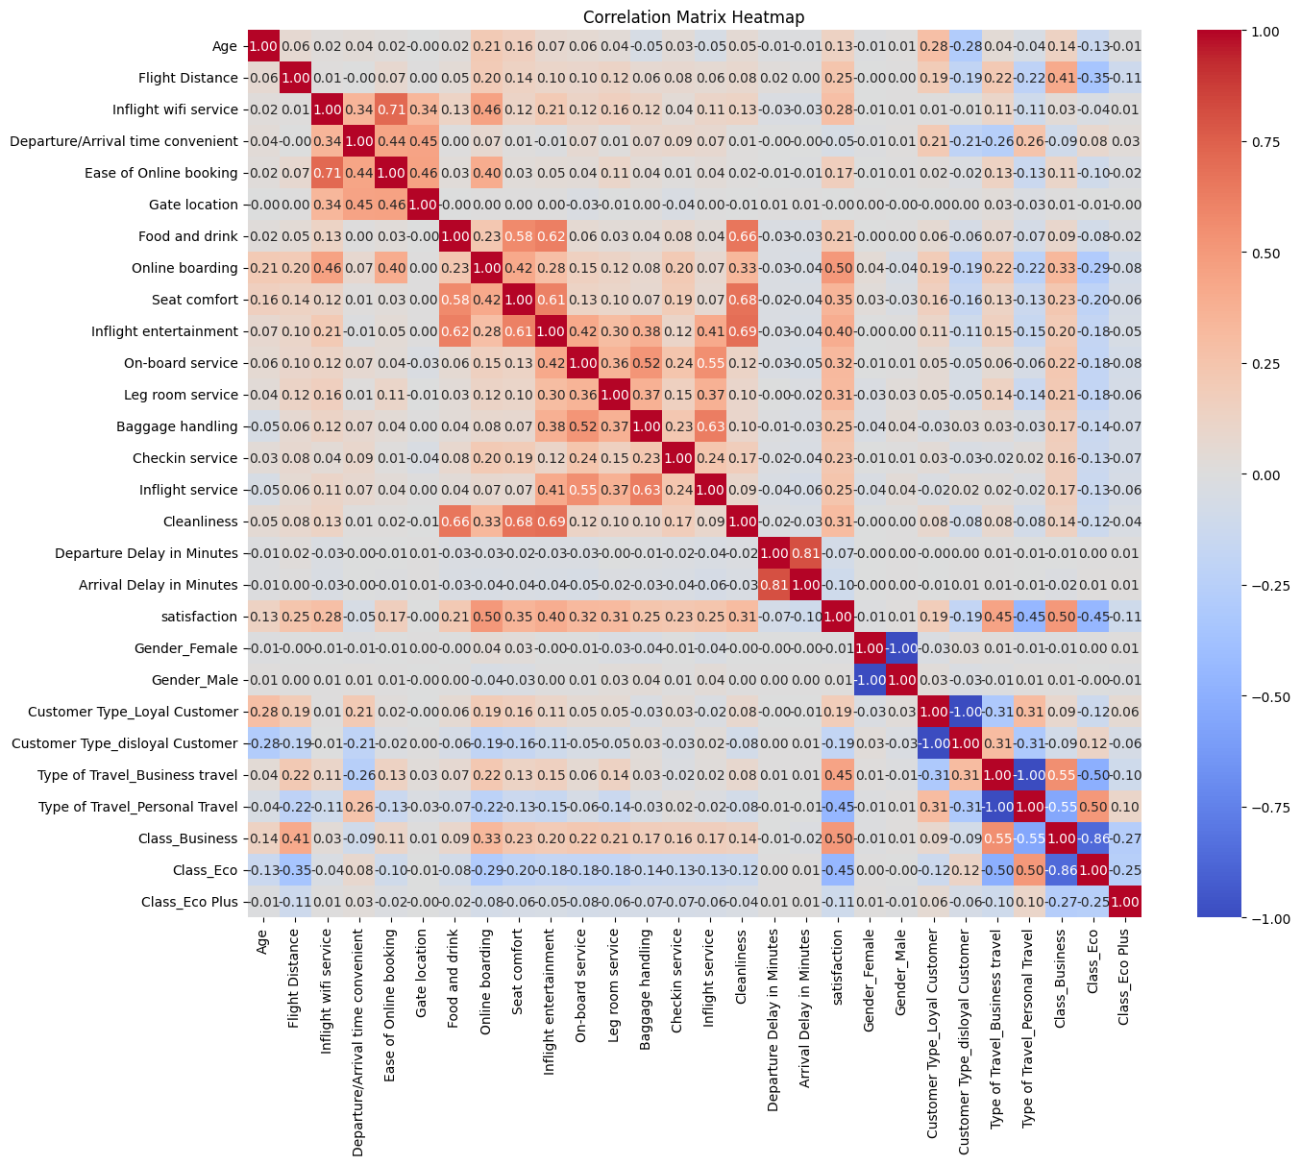
Correlation matrix of all features:
Strong Correlations:
Inflight Wi-Fi service with Ease of online booking
Cleanliness with inflight entertainment/Food and Drink/Seat Comfort
Baggage handling with inflight service
Flight distance with Business Class

Slide 12
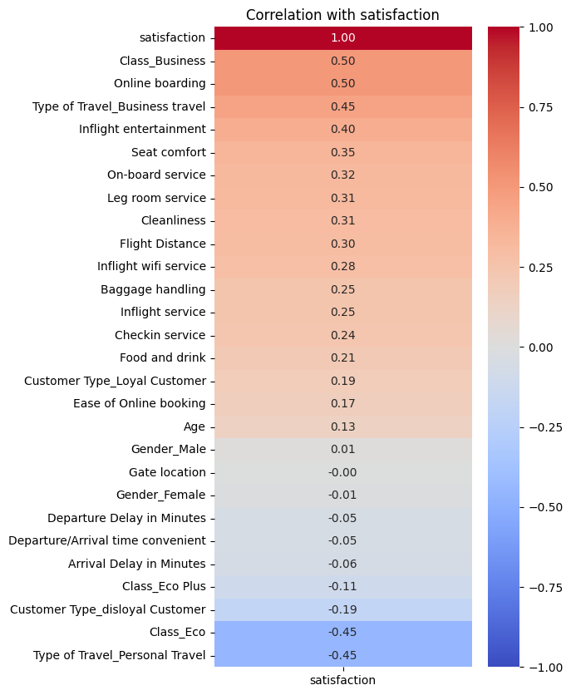
Three strongest positive correlations:
business class travel
online boarding
inflight entertainment
The three strongest negative correlations:
personal travel
economy Class
disloyal customers.

Slide 13

MACHINE LEARNING

Slide 14
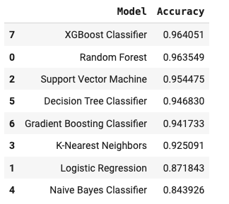
Applied Standard Scaler function on all models. XGBoost Classifier is the best performing model. Scaling advantages: 1. Enhanced Model Performance 2. Improved Convergence Speed 3.Equal Contribution of Features: Without standardization, features with larger scales might dominate the learning process, leading to biased results.
Model Evaluation with Standard Scaling:

Slide 15
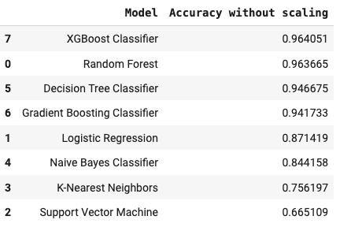
Compared to model performance with scaling technique, four models showed reduced performance while other models were not affected. XGBoost Classifier is still best performing model indicating insensitive to scaling. Models were found which were sensitive to scaling: - Logistic Regression - K-Nearest Neighbors - Support Vector Machine - Naive Bayes Classifier
Model Evaluation with no scaling:

Slide 16
Used IQR technique to detect and remove outliers. Four columns had outliers as follows: Number of outliers in Flight Distance: 2847 Number of outliers in Checkin service: 16059 Number of outliers in Departure Delay in Minutes: 17970 Number of outliers in Arrival Delay in Minutes: 17492 Original dataframe rows: 129880 Dataframe rows after removing outliers: 82637
Model Evaluation with outliers removed:

Slide 17
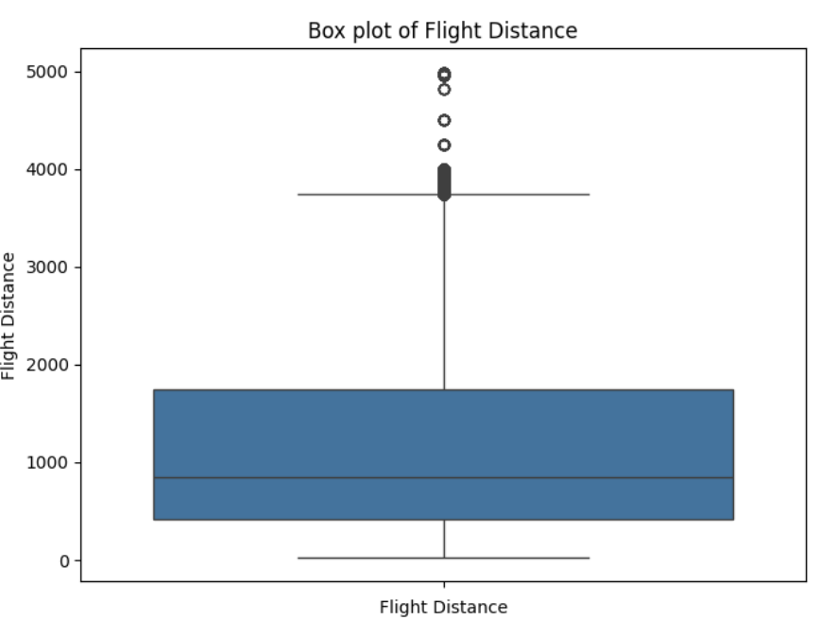
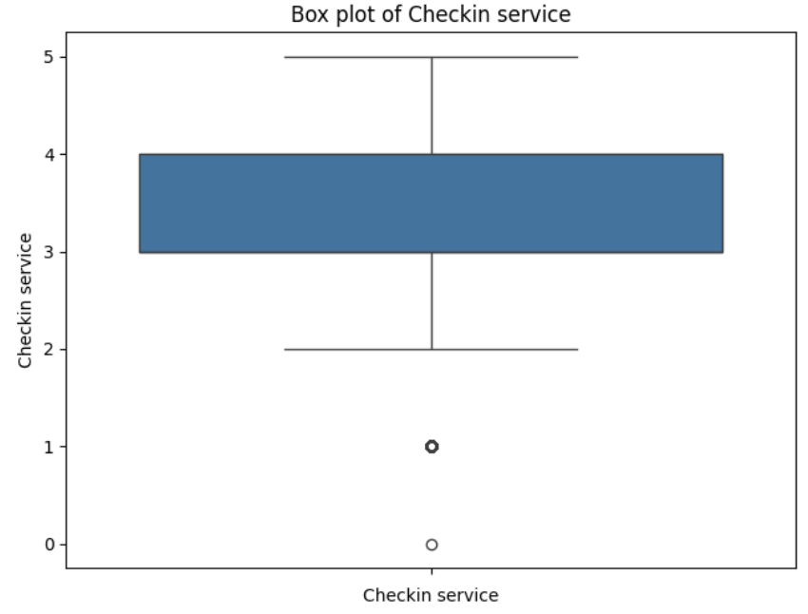
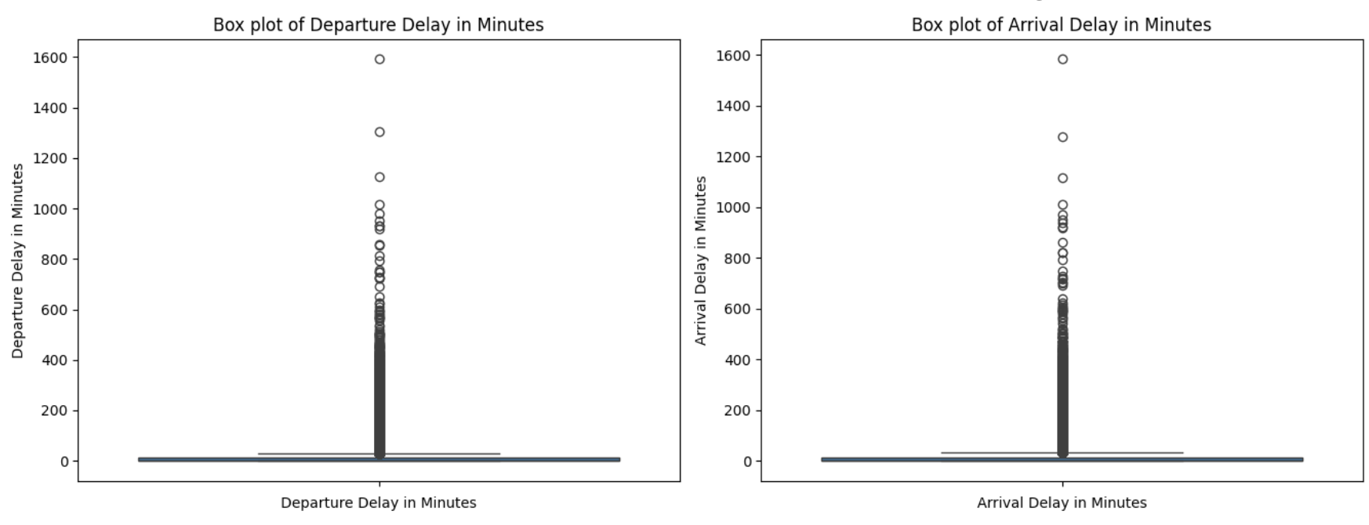

Slide 18
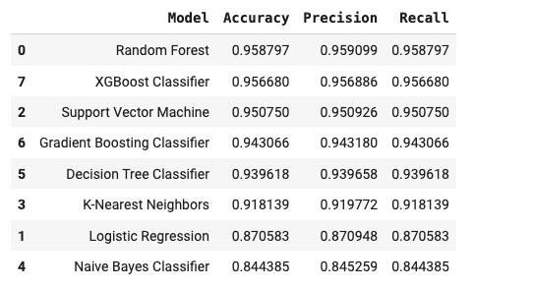
Compared to model performance with scaling technique, all models showed decrease in performance. Random Forest is best performing model followed by XGBoost classifier.
Model Evaluation with outliers removed:

Slide 19
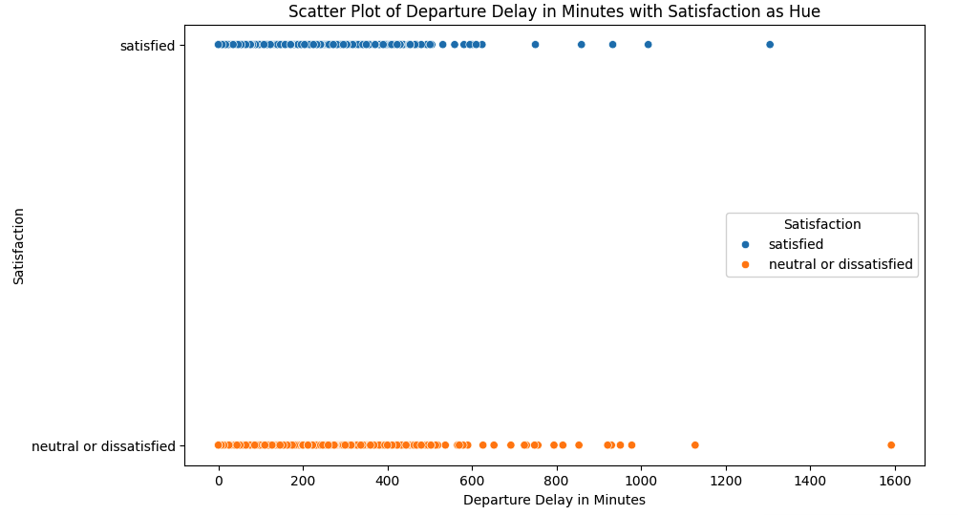
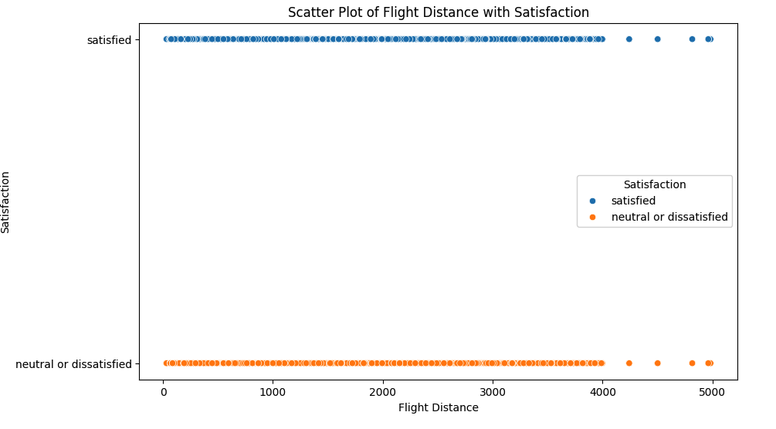
Outliers can be data errors or natural values in real world. Considering this dataset, we think outliers in this dataset are values we can get in real world. The difference between 129880 and 82637 is approximately 36.37% of 129880. When we removed outliers, we also lost a chunk of data that impacted our modal performance.

Slide 20
We used Log Transformation Technique to:
Normalize highly skewed data.
Mitigate the impact of outliers by compressing the range of large values. This can make the dataset more robust to outliers and improve the performance of algorithms sensitive to outliers.

Slide 21
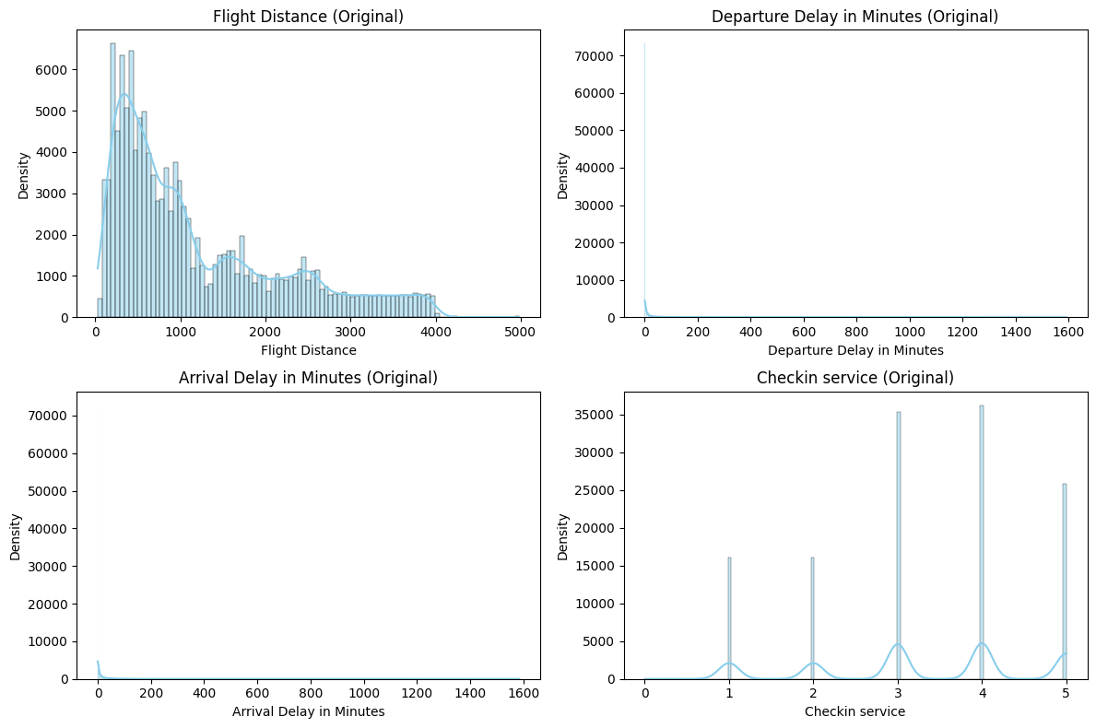
Distribution before Log Transformation:

Slide 22
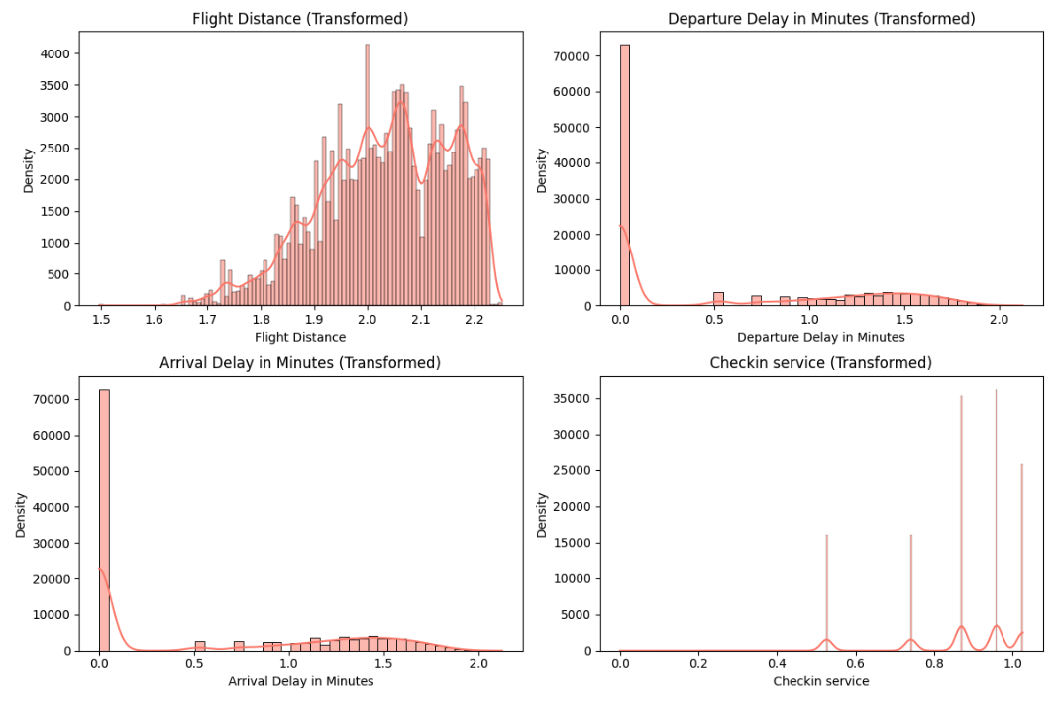
Distribution After Log Transformation:

Slide 23
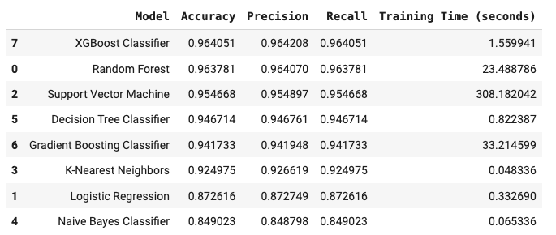
Compared to model performance with scaling techique, all models showed increase in performance. XGBoost Classifier is best performing model. Although there was minimal difference between accuracy scores (96.40% and 96.37%) between XGBoost Classifier and Random Forest, XGBoost Classifier had an edge over Random Forest in training time speed.
Model Evaluation with Log Transformation Technique:

Slide 25

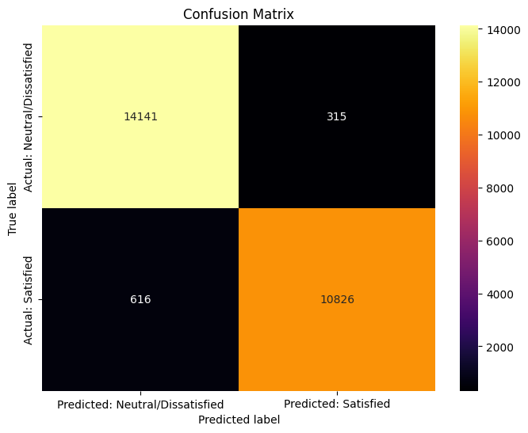
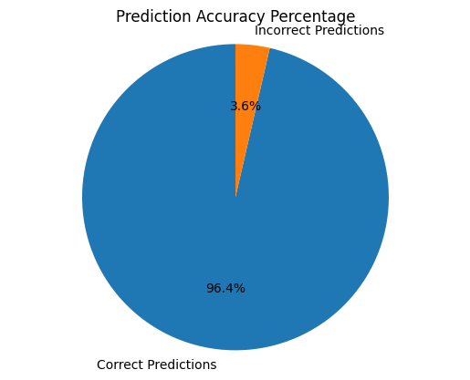
The best performing model we found is the XGBoost Classifier:

Slide 26
Measuring Model Performance by ROC-AUC:
In machine learning, the performance of binary classification models is assessed using a crucial metric called the Area Under the Receiver Operating Characteristic (AUC-ROC).
AUC measures how well a model can distinguish between classes.

Slide 27
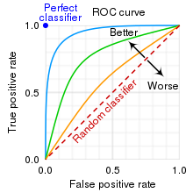
Interpreting ROC-AUC:
A high AUC (close to 1) indicates excellent discriminative power. This means the model is effective in distinguishing between the two classes, and its predictions are reliable.
A low AUC (close to 0) suggests poor performance. In this case, the model struggles to differentiate between the positive and negative classes, and its predictions may not be trustworthy.
AUC around 0.5 implies that the model is essentially making random guesses. It shows no ability to separate the classes, indicating that the model is not learning any meaningful patterns from the data.

Slide 28
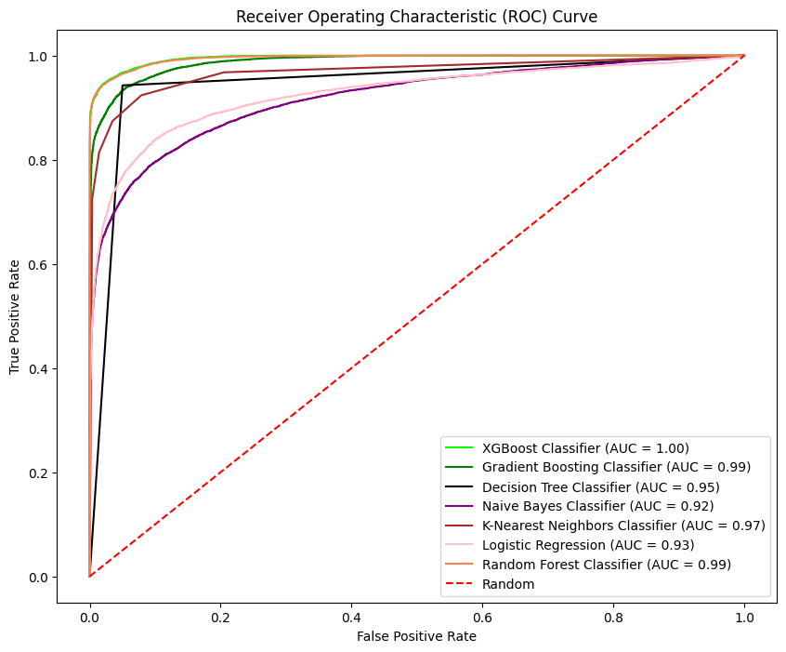
Model Performance by ROC-AUC:
The Area Under the Receiver Operating Characteristic (AUC-ROC) Curve for all models show XGBoost Classifier is the best performing model.

Slide 29
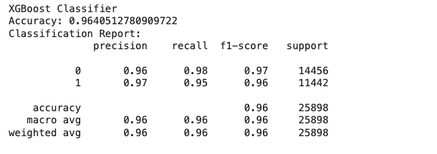
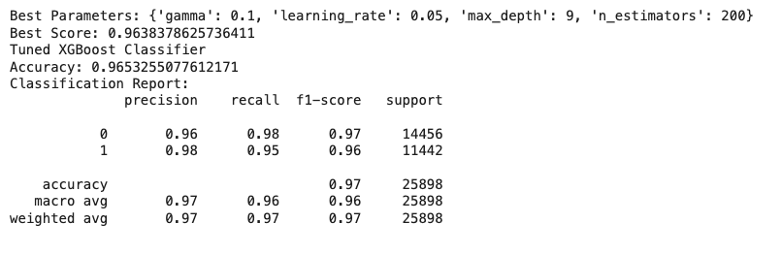
MODEL OPTIMIZATION:
Used Grid Search technique for optimization using hyperparameters tuning method.
BEFORE TUNING:
AFTER TUNING:

Slide 30
HYPERPARAMETER TUNING RESULTS:
Before Tuning:
The initial XGBoost model, trained with default hyperparameters, achieved an accuracy of approximately 96.40% on the test data.
After tuning:
After performing hyperparameter tuning using GridSearchCV, the best XGBoost model achieved an improved accuracy of approximately 96.53% on the test data.
The best parameters found during tuning were:
gamma: 0.1
learning_rate: 0.05
max_depth: 9
n_estimators: 200

Slide 31
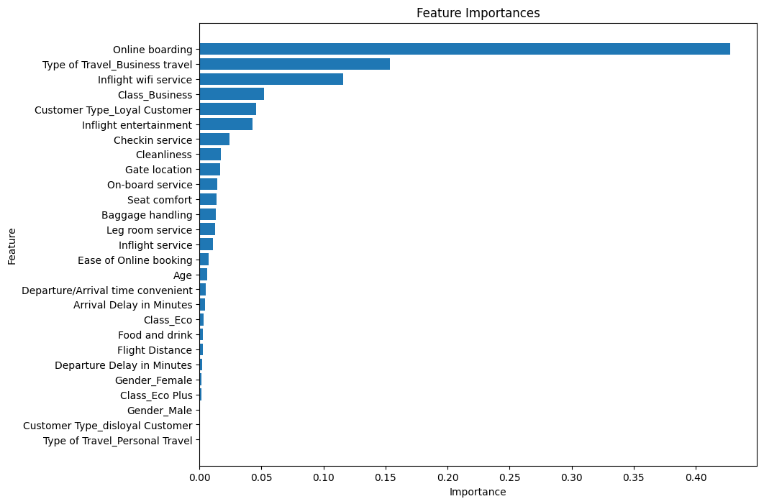
FEATURE IMPORTANCE:
Feature Importance Calculation: XGBoost provides built-in functions to calculate feature importance, which helps in understanding the influence of different features on the model's predictions.

Slide 32
Feature importance analysis:
Satisfaction of passengers is most strongly influenced by factors such as the online boarding experience, business travel, and the quality of inflight Wi-Fi service.
Features related to the class of travel, customer loyalty, and inflight entertainment also play a notable role.
Other features, although included in the model, contribute significantly less to the prediction outcomes. This insight can guide improvements in service areas that matter most to passengers, potentially leading to higher satisfaction and better model performance.

Slide 33
CONCLUSION:
The project successfully identified the most important features influencing customer satisfaction and predicted satisfaction with high accuracy, precision, and recall.
The best-performing model after hyperparameter tuning was the XGBoost Classifier, with an accuracy improvement from 96.40% to 96.53%.
XGBoost (Extreme Gradient Boosting) is a powerful and popular machine learning algorithm, especially for supervised learning tasks.
Here are some of the key advantages of using the XGBoost classifier in this project:
Performance : XGBoost is known for its high performance in terms of accuracy.
Speed: Built for speed, perfect for large datasets.
It can handle unbalanced datasets effectively.
XGBoost includes regularization parameters (L1 and L2) which help prevent overfitting.
XGBoost provides built-in functions to calculate feature importance, which helps in understanding the influence of different features on the model's predictions.

